Slide 1
Module 13
Monitoring Windows Server 2012
Notes:
Presentation: 60 minutes
Lab: 60 minutes
After completing this module, students will be able to:
Describe the monitoring tools for the Windows Server® 2012 operating system.
Use the Performance Monitor tool to view and analyze performance statistics of programs that are running on their servers.
Monitor event logs to view and interpret the recorded events.
Required materials
To teach this module, you need the Microsoft® Office PowerPoint® file 20411D_13.pptx.
Important: We recommend that you use Office PowerPoint 2007 or a newer version to display the slides for this course. If you use PowerPoint Viewer or an older version of PowerPoint, all the features of the slides might not display correctly.
Preparation tasks
To prepare for this module:
Read all of the materials for this module.
Practice performing the demonstrations and the lab exercises.
Work through the Module Review and Takeaways section, and determine how you will use this section to reinforce student learning and promote knowledge transfer to on-the-job performance.
20411D
13: Monitoring Windows Server 2012

Slide 2
Module Overview
Monitoring Tools Using Performance Monitor Monitoring Event Logs
Notes:
20411D
13: Monitoring Windows Server 2012

Slide 3
Lesson 1: Monitoring Tools
Overview of Task Manager Overview of Performance Monitor Overview of Resource Monitor Overview of Reliability Monitor Overview of Event Viewer Monitoring a Server With Server Manager
Notes:
Provide an overview of the topics that you will discuss with students in this lesson.
20411D
13: Monitoring Windows Server 2012

Slide 4
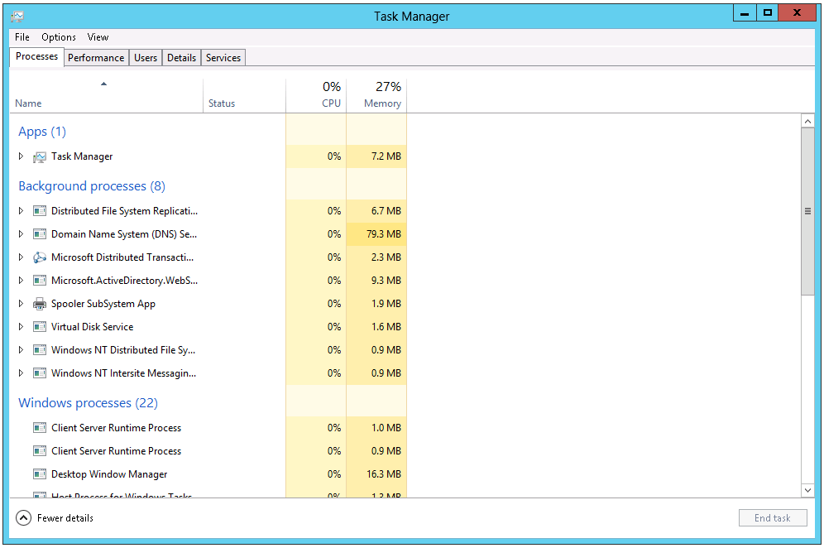
Overview of Task Manager
Task Manager helps you to identify and resolve performance-related issues
Notes:
Consider demonstrating Task Manager as you discuss the contents of each tab.
20411D
13: Monitoring Windows Server 2012

Slide 5
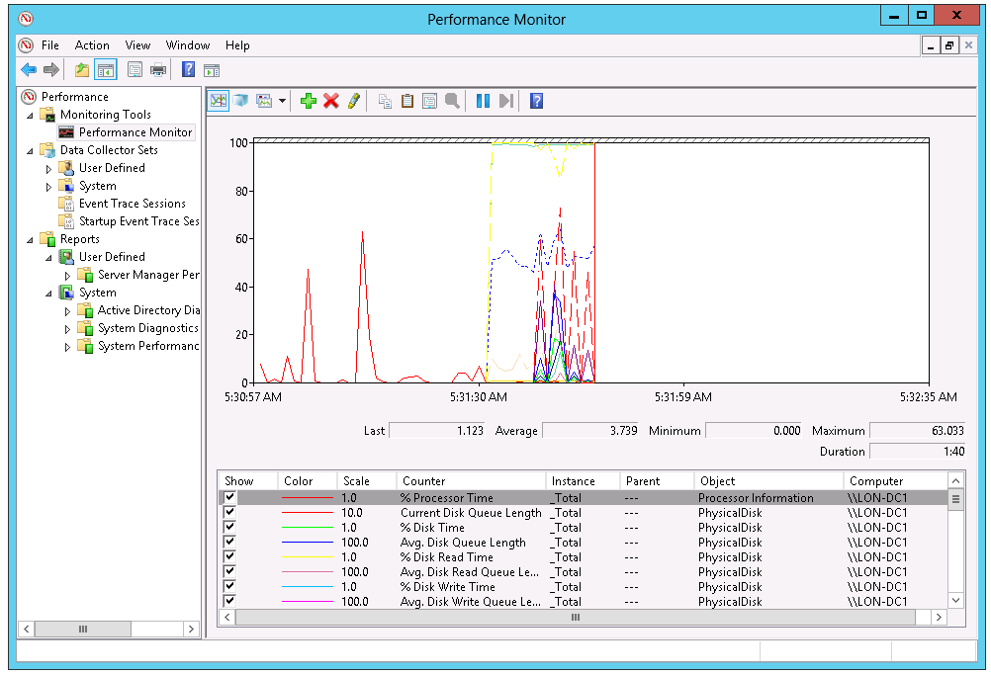
Overview of Performance Monitor
Performance Monitor enables you to view current performance statistics or to view historical data
Data Collector Sets have gathered
Notes:
You can use Performance Monitor to examine how the programs you run affect your server’s performance, both in real time and by collecting log data for later analysis.
To access Performance Monitor, in the Performance Information and Tools page, select Advanced Tools.
You can view data through Performance Monitor by using:
Monitoring tools.
Data collector sets.
Reports.
Briefly mention that you can access Resource Monitor from Performance Monitor.
Inform students that during the process of installing other applications, such as Microsoft Exchange Server or Microsoft SQL Server® data-management software, Windows Server adds application-specific Exchange Server and SQL Server performance counters to Performance Monitor.
20411D
13: Monitoring Windows Server 2012

Slide 6
Overview of Performance Monitor
Primary Processor Counters:
Processor > % Processor Time
Processor > Interrupts/sec
System > Processor Queue Length
Primary Disk Counters:
Physical Disk > % Disk Time
Physical Disk > Avg. Disk Queue Length
Primary Network Counters:
Network Interface > Current Bandwidth
Network Interface > Output Queue Length
Network Interface > Bytes Total/sec
Primary Memory Counter:
The Memory > Pages/sec counter
Notes:
20411D
13: Monitoring Windows Server 2012

Slide 7
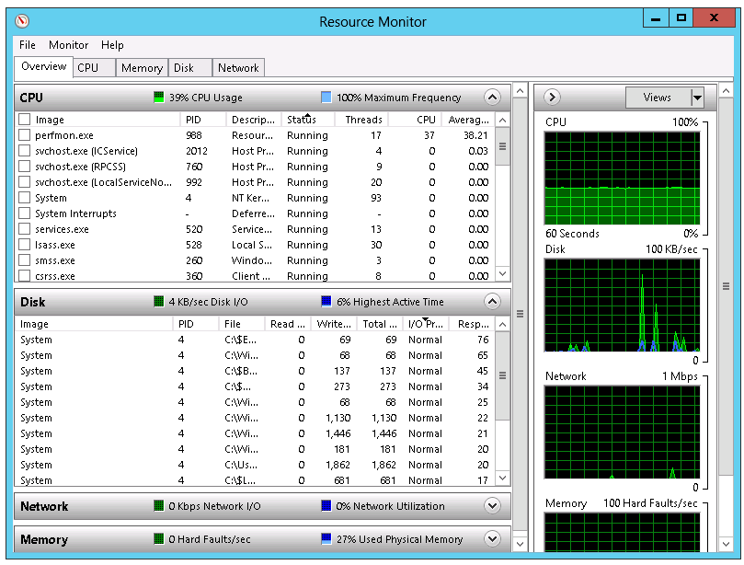
Overview of Resource Monitor
Resource Monitor provides an in-depth look at the real-time performance of
your server
Notes:
Explain how the Resource Monitor interface in Windows Server 2012 provides an in-depth look at a server’s real-time performance. Explain how students can use Resource Monitor to monitor the use and performance of CPU, disk, network, and memory resources in real time. This enables you to identify and resolve resource conflicts and bottlenecks.
20411D
13: Monitoring Windows Server 2012

Slide 8
Overview of Reliability Monitor
Monitors hardware and software issues
Provides Stability Index number (from 1 to 10)
1 represents lowest stability
10 represents highest stability
Reliability monitor window components include:
Historical reports on stability index
Reliability details
Action to be performed: saving historical data, starting Problem Reports console, checking online for a solution to specific problem
Notes:
Explain how Reliability Monitor works, and demonstrate the Reliability Monitor console in order to explain information that it makes available.
20411D
13: Monitoring Windows Server 2012

Slide 9
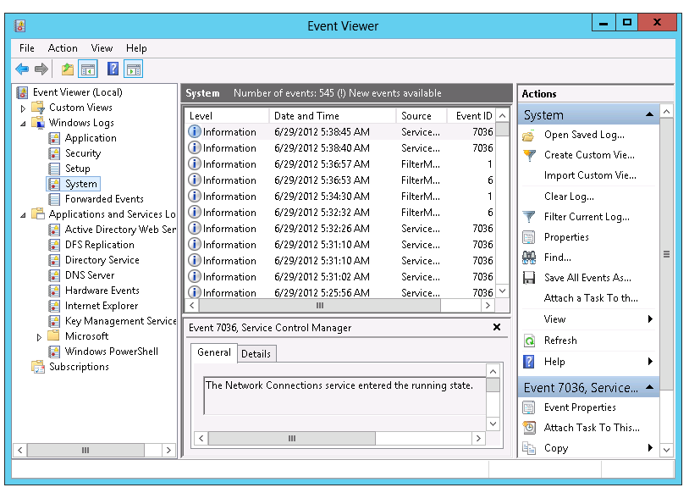
Overview of Event Viewer
Event Viewer provides categorized lists of essential Windows log events, and log groupings for individual installed applications and specific Windows component categories
Notes:
Most students should be familiar with the basics of Event Viewer. Consider demonstrating the Applications and Services Logs node.
20411D
13: Monitoring Windows Server 2012

Slide 10
Overview of Event Viewer
Event Viewer provides the ability to
View multiple logs
Create customized views
Configure tasks scheduled to run in response to events
Create and manage event subscriptions
Event Viewer has many built-in logs such as
Application log
Security log
Setup log
System log
Forwarded events
Notes:
20411D
13: Monitoring Windows Server 2012

Slide 11
Monitoring a Server With Server Manager
Server Manager console:
Installed by default on Windows Server 2012, can be installed on Windows 8
Supports monitoring of Windows Server operating systems
Provides a centralized monitoring dashboard
Analyzes or troubleshoots different types of issues
Identifies critical events
Monitors the status of Best Practices Analyzer tool
Notes:
Explain scenarios to students where they can use Server Manager to monitor servers that are running the Windows® operating system. Also, show the Server Manager console to students, and demonstrate several ways to monitor information from the console.
20411D
13: Monitoring Windows Server 2012

Slide 12
Lesson 2: Using Performance Monitor
Performance Baselines, Trends, and Capacity Planning What Are Data Collector Sets? Demonstration: Capturing Counter Data with a Data Collector Set What Are Alerts? Demonstration: Configuring an Alert Demonstration: Viewing Reports in Performance Monitor Monitoring Network Infrastructure Services Considerations for Monitoring Virtual Machines
Notes:
20411D
13: Monitoring Windows Server 2012
Provide an overview of the topics that you will discuss in this lesson.

Slide 13
Performance Baselines, Trends, and Capacity Planning
By calculating performance baselines for your server environment, you can more accurately interpret real-time monitoring information
By establishing a baseline, you can:
Interpret performance trends
Perform capacity planning
Identify bottlenecks
Analyze performance trends to predict when existing capacity is likely to be exhausted
Plan the capacity for the key hardware components: processor, disk, memory and network
Notes:
Ask students whether they have experience using data-gathering tools to establish a performance baseline. Remind students that the baseline should include certain core components. The four main hardware components to monitor in any Windows Server installation are:
Processor
Disk
Memory
Network
By understanding how the operating system uses these four key hardware components, and how they interact with one another, you begin to understand how to optimize server performance.
When monitoring performance, you should consider:
The measurement of all key server components.
The server role and workload, to determine which hardware components are likely to restrict performance.
The ability to increase server performance by adding power or by reducing the number of applications that the user is running.
20411D
13: Monitoring Windows Server 2012

Slide 14
What Are Data Collector Sets?
Data collector sets enable you to gather performance-related and other system statistics for analysis
Data collector sets can contain the following types of data collectors:
Performance counters
Event trace data
System configuration information
Notes:
Describe data collector sets. In the next topic, you will demonstrate them.
20411D
13: Monitoring Windows Server 2012

Slide 15
Demonstration: Capturing Counter Data with a Data Collector Set
In this demonstration, you will see how to:
Create a data collector set
Create a disk load on the server
Analyze the resulting data in a report
Notes:
Leave the virtual machines running for subsequent demonstrations.
Preparation Steps
You require the 20411D-LON-DC1 and 20411D-LON-SVR1 virtual machines for this demonstration.
Demonstration Steps
Create a data collector set
Switch to the LON-SVR1 computer.
Sign in as Adatum\Administrator with the password Pa$$w0rd.
Click Start, and then type Perf in the search box.
In the Apps list, click Performance Monitor.
In Performance Monitor, in the navigation pane, expand Data Collector Sets, and then click User Defined.
Right-click User Defined, point to New, and then click Data Collector Set.
In the Create New Data Collector Set Wizard, in the Name box, type LON-SVR1 Performance.
Click Create manually (Advanced), and then click Next.
On the What type of data do you want to include? page, select the Performance counter check box, and then click Next.
On the Which performance counters would you like to log? page, click Add.
In the Available counters list, expand Processor, click % Processor Time, and then click Add >>.
In the Available counters list, expand Memory, click Pages/sec, and then click Add >>.
In the Available counters list, expand PhysicalDisk, click % Disk Time, and then click Add >>.
Click Avg. Disk Queue Length, and then click Add >>.
20411D
13: Monitoring Windows Server 2012
(More notes on the next slide)

Slide 16
Notes:
In the Available counters list, expand System, click Processor Queue Length, and then click Add >>.
In the Available counters list, expand Network Interface, click Bytes Total/sec, click Add >>, and then click OK.
On the Which performance counters would you like to log? page, in the Sample interval box, type 1, and then click Next.
On the Where would you like the data to be saved? page, click Next.
On the Create the data collector set? page, click Save and close, and then click Finish.
In Performance Monitor, in the results pane, right-click LON-SVR1 Performance, and then click Start.
Create a disk load on the server
On the taskbar, click the Windows PowerShell icon.
At the Windows PowerShell® prompt, type the following command, and then press Enter:
Fsutil file createnew bigfile 104857600
At the command prompt, type the following command, and then press Enter:
Copy bigfile \\LON-dc1\c$
At the command prompt, type the following command, and then press Enter:
Copy \\LON-dc1\c$\bigfile bigfile2
At the command prompt, type the following command, and then press Enter:
Del bigfile*.*
At the command prompt, type the following command, and then press Enter:
(More notes on the next slide)
20411D
13: Monitoring Windows Server 2012

Slide 17
Notes:
Del \\LON-dc1\c$\bigfile*.*
Close the command prompt.
Analyze the resulting data in a report
Switch to Performance Monitor.
In the navigation pane, right-click LON-SVR1 Performance, and then click Stop.
In Performance Monitor, in the navigation pane, click Performance Monitor.
On the toolbar, click View log data icon.
In the Performance Monitor Properties dialog box, on the Source tab, click Log files, and then click Add.
In the Select Log File dialog box, double-click Admin.
Double-click LON-SVR1 Performance, double-click the LON-SVR1_date-000001 folder, and then double-click DataCollector01.blg.
Click the Data tab, and then click Add.
In the Add Counters dialog box, in the Available counters list, expand Memory, click Pages/sec, and then click Add >>.
Expand Network Interface, click Bytes Total/sec, and then click Add >>.
Expand PhysicalDisk, click %Disk Time, and then click Add >>.
Click Avg. Disk Queue Length, and then click Add >>.
Expand Processor, click %Processor Time, and then click Add >>.
Expand System, click Processor Queue Length, click Add >>, and then click OK.
In the Performance Monitor Properties dialog box, click OK.
On the toolbar, on the Change graph type icon, click the down arrow, and then click Report.
(More notes on the next slide)
20411D
13: Monitoring Windows Server 2012

Slide 18
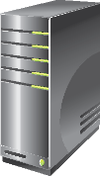

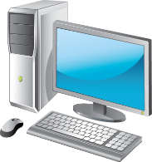

What Are Alerts?
An alert notifies the administrator of events that have occurred or performance thresholds that have been reached
When creating an alert, configure the following settings:
Alert when
Alert Action
Alert Task
Notes:
Discuss with students scenarios in which they could use alerts.
20411D
13: Monitoring Windows Server 2012

Slide 19
Demonstration: Configuring an Alert
In this demonstration, you will see how to:
Create a data collector set with an alert counter
Generate a server load that exceeds the configured threshold
Examine the event log for the resulting event
Notes:
Leave the virtual machines running for subsequent demonstrations.
Preparation Steps
The required virtual machines, 20411D-LON-DC1 and 20411D-LON-SVR1, should be running after the preceding demonstration.
Demonstration Steps
Create a data collector set with an alert counter
On LON-SVR1 computer, in Performance Monitor, in the navigation pane, expand Data Collector Sets, and then click User Defined.
Right-click User Defined, point to New, and then click Data Collector Set.
In the Create New Data Collector Set Wizard, in the Name box, type LON-SVR1 Alert.
Click Create manually (Advanced), and then click Next.
On the What type of data do you want to include? page, click Performance Counter Alert, and then click Next.
On the Which performance counters would you like to monitor? page, click Add.
In the Available counters list, expand Processor, click %Processor Time, click Add >>, and then click OK.
On the Which performance counters would you like to monitor? page, in the Alert when list, click Above.
In the Limit box, type 10, and then click Next.
On the Create the data collector set? page, click Finish.
In the navigation pane, expand the User Defined node, and then click LON-SVR1 Alert.
In the results pane, right-click DataCollector01, and then click Properties.
20411D
13: Monitoring Windows Server 2012
(More notes on the next slide)

Slide 20
Notes:
In the DataCollector01 Properties dialog box, in the Sample interval box, type 1, and then click the Alert Action tab.
Select the Log an entry in the application event log check box, and then click OK.
In the navigation pane, right-click LON-SVR1 Alert, and then click Start.
Generate a server load that exceeds the configured threshold
At the Windows PowerShell prompt, type the following commands, and then press Enter after each command:
C:
Cd \Labfiles
At the Windows PowerShell prompt, type the following commands, and then press Enter:
.\StressTool.exe 95
Wait one minute to allow generation of alerts.
Press Ctrl+C.
Close the command prompt.
Examine the event log for the resulting event
Click Start, and on the Start screen, type Event, and then in the Apps list, click Event Viewer.
In Event Viewer, in the navigation pane, expand Applications and Services Logs, expand Microsoft, expand Windows, expand Diagnosis-PLA, and then click Operational.
Examine the log for performance-related messages. These have an Event ID of 2031. Leave Event Viewer running.
(More notes on the next slide)
20411D
13: Monitoring Windows Server 2012

Slide 21
Demonstration: Viewing Reports in Performance Monitor
In this demonstration, you will see how to view a performance report
Notes:
Preparation Steps
The required virtual machines, 20411D-LON-DC1 and 20411D-LON-SVR1, should be running after the preceding demonstration.
Demonstration Steps
View a performance report
On LON-SVR1, in Performance Monitor, in the navigation pane, expand Reports, expand User Defined, and then click LON-SVR1 Performance.
Expand the folder beneath LON-SVR1 Performance. The data collector set’s previous collection process generated this report. You can change from the chart view to any other supported view.
If the report is not displayed, click the Refresh button on the toolbar, and then repeat Step 2.
Close all open windows.
20411D
13: Monitoring Windows Server 2012

Slide 22
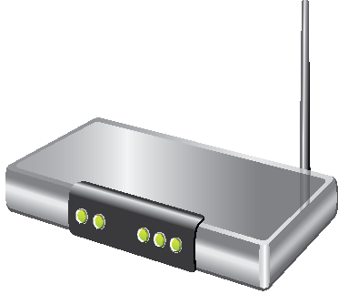
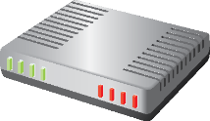



Monitoring Network Infrastructure Services
Monitoring is essential for:
Optimizing network infrastructure server performance
Troubleshooting servers
Active Directory
Internet
DHCP server
DNS server
Perimeter network
Intranet
Notes:
Describe how to monitor a network, and discuss with students that in order to have a healthy and performance-reliable IT environment, you should monitor not only the server components, but also the networking components.
Provide the following examples:
Poor Domain Name System (DNS) performance will affect many critical services, such as Active Directory® Domain Services (AD DS), Internet access, and other applications that depend on AD DS, such as Exchange Server, Microsoft SQL Server® data-management software, and Microsoft SharePoint® Server 2013.
If Dynamic Host Configuration Protocol (DHCP) has poor performance, the clients cannot obtain IP addresses. This results in limited network connectivity.
20411D
13: Monitoring Windows Server 2012

Slide 23
Considerations for Monitoring Virtual Machines
Considerations for monitoring virtual machines:
Virtual machines must be assigned sufficient resources for their workload
If multiple virtual machines run on a host, ensure the host has enough resources
Resources are shared, so performance of one virtual machine can affect the performance of others
You must remember to monitor the resource utilization on the host as well as the guests
Notes:
Emphasize to students that monitoring virtual machines is no different that monitoring host-based servers, and that they can use the same tools and techniques. However, also mention that they can use resource metering specifically for virtual machine monitoring.
20411D
13: Monitoring Windows Server 2012

Slide 24
Lesson 3: Monitoring Event Logs
Using Server Manager to View Event Logs What Is a Custom View? Demonstration: Creating a Custom View What Are Event Subscriptions? Demonstration: Configuring an Event Subscription
Notes:
20411D
13: Monitoring Windows Server 2012
Provide an overview of the topics that the lesson will discuss.

Slide 25
Using Server Manager to View Event Logs
Server Manager provides a centralized location for event logs from remote servers
Event logging
Enabled by default
Categorized by technology: AD DS, DNS, Remote Access
Customized views
Create queries for specific types of events that need to be displayed
Configure event data that needs to be displayed
Notes:
20411D
13: Monitoring Windows Server 2012
Explain to students the scenarios in which you would use Server Manager for viewing event logs from different remote Windows servers. Also, display the Server Manager console to students, and demonstrate how you can monitor event-log information from the console.

Slide 26
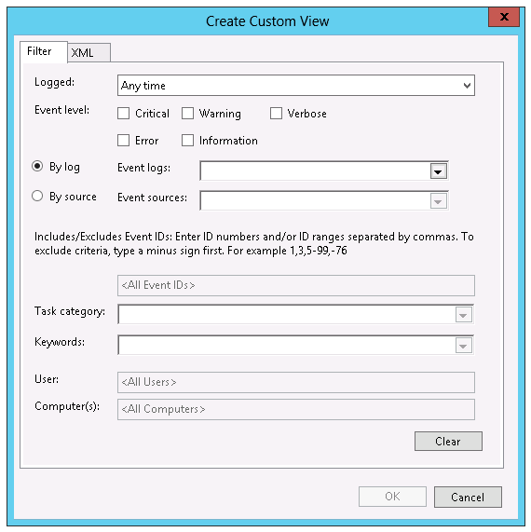
What Is a Custom View?
Custom views allow you to query and sort just the events that you want
to analyze
Notes:
Remind students that event logs contain vast amounts of data, and it could be challenging to narrow the set of events to just those of interest.
20411D
13: Monitoring Windows Server 2012

Slide 27
Demonstration: Creating a Custom View
In this demonstration, you will see how to:
View Server Roles custom views
Create a custom view
Notes:
Leave the virtual machines running for subsequent demonstrations.
Preparation Steps
The required virtual machines, 20411D-LON-DC1 and 20411D-LON-SVR1, should be running after the preceding demonstration.
Demonstration Steps
View Server Roles custom views
On LON-SVR1, open Event Viewer.
In the navigation pane, expand Custom Views, expand Server Roles, and then click Web Server (IIS). This is the Web Server role-specific custom view.
Create a custom view
In the navigation pane, right-click Custom Views, and then click Create Custom View.
In the Create Custom View dialog box, select the Critical, Warning, and Error check boxes.
In the Create Custom View dialog box , in the Event logs drop-down list, expand Windows Logs, and then select the System and Application check boxes. Click the mouse pointer back into the Create Custom View dialog box, and then click OK.
In the Save Filter to Custom View dialog box, in the Name box, type Adatum Custom View, and then click OK.
In Event Viewer, in the right pane, view the events that are visible within your custom view.
20411D
13: Monitoring Windows Server 2012

Slide 28

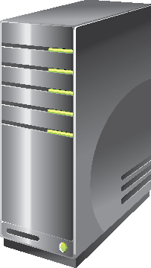
What Are Event Subscriptions?
Event subscriptions allow you to collect event logs from multiple servers, and then store them locally
Notes:
Explain that Event Viewer includes the ability to collect copies of events from multiple remote computers, and then store them locally. To specify which events to collect, create an event subscription. Among other details, the subscription specifies exactly which events will be collected and in which log they will be stored locally. After a subscription is active and events are being collected, you can view and manipulate these forwarded events as you would any other locally stored events.
Explain that before you can create a subscription to collect events on a computer, you must configure the collecting computer (the collector) and each computer from which events will be collected (the source).
20411D
13: Monitoring Windows Server 2012

Slide 29
Demonstration: Configuring an Event Subscription
In this demonstration, you will see how to:
Configure the source computer
Configure the collector computer
Create and view the subscribed log
Notes:
Preparation Steps
The required virtual machines, 20411D-LON-DC1 and 20411D-LON-SVR1, should be running after the preceding demonstration.
Demonstration Steps
Configure the source computer
Switch to LON-DC1.
Sign in as Adatum\Administrator with the password Pa$$w0rd.
Click Start, and then type Cmd in the search box.
In the Apps list, click Command Prompt.
At the command prompt, type the following command, and then press Enter:
winrm quickconfig
Note that the service is already running.
From the Server Manager, click Tools, and then click Active Directory Users and Computers.
In Active Directory Users and Computers console, in the navigation pane, expand Adatum.com, and then click Builtin.
In the results pane, double-click Administrators.
In the Administrators Properties dialog box, click the Members tab.
Click Add, and, in the Select Users, Contacts, Computers, Service Accounts, or Groups dialog box, click Object Types.
In the Object Types dialog box, select the Computers check box, and then click OK.
In the Select Users, Contacts, Computers, Service Accounts, or Groups dialog box, in the Enter
20411D
13: Monitoring Windows Server 2012
(More notes on the next slide)

Slide 30
Notes:
the object names to select box, type LON-SVR1, and then click OK.
In the Administrator Properties dialog box, click OK.
Configure the collector computer
Switch to LON-SVR1.
Click Start, and then type Cmd in the Search box.
In the Apps list, click Command Prompt.
At the command prompt, type the following command, and then press Enter:
Wecutil qc
When prompted, type Y, and then press Enter.
Create and view the subscribed log
In Event Viewer, in the navigation pane, click Subscriptions.
Right-click Subscriptions, and then click Create Subscription.
In the Subscription Properties dialog box, in the Subscription name box, type LON-DC1 Events.
Click Collector Initiated, and then click Select Computers.
In the Computers dialog box, click Add Domain Computers.
In the Select Computer dialog box, in the Enter the object name to select box, type LON-DC1, and then click OK.
In the Computers dialog box, click OK.
In the Subscription Properties – LON-DC1 Events dialog box, click Select Events.
In the Query Filter dialog box, select the Critical, Warning, Information, Verbose, and Error check boxes.
(More notes on the next slide)
20411D
13: Monitoring Windows Server 2012

Slide 31
Notes:
In the Logged drop-down list, click Last 30 days.
In the Event logs drop-down list, select Windows Logs. Click the mouse pointer back into the Query Filter dialog box, and then click OK.
In the Subscription Properties – LON-DC1 Events dialog box, click OK.
In Event Viewer, in the navigation pane, expand Windows Logs.
Click Forwarded Events.
Examine any listed events.
20411D
13: Monitoring Windows Server 2012

Slide 32
Lab: Monitoring Windows Server 2012
Exercise 1: Establishing a Performance Baseline Exercise 2: Identifying the Source of a Performance Problem Exercise 3: Viewing and Configuring Centralized Event Logs
Logon Information
Virtual Machines: 20411D-LON-DC1,
20411D-LON-SVR1
User Name: Adatum\Administrator
Password: Pa$$w0rd
Estimated Time: 60 minutes
Notes:
Exercise 1: Establishing a Performance Baseline
In this exercise, you will use Performance Monitor on the server, and create a baseline by using typical performance counters.
Exercise 2: Identifying the Source of a Performance Problem
In this exercise, you will simulate a load to represent the system in live usage, gather performance data by using your data collector set, and then determine the potential cause of the performance problem.
Exercise 3: Viewing and Configuring Centralized Event Logs
In this exercise, you will use LON-DC1 to collect event logs from LON-SVR1. Specifically, you will use this process to gather performance-related alerts from your network servers.
20411D
13: Monitoring Windows Server 2012

Slide 33
Lab Scenario
A. Datum Corporation is a global engineering and manufacturing company with its head office in London, England. An IT office and data center are in London to support the London location and other locations. A. Datum recently deployed a Windows Server 2012 server and client infrastructure.
Because the organization has deployed new servers, it is important to establish a performance baseline with a typical load for these new servers. You have been asked to work on this project.
Notes:
20411D
13: Monitoring Windows Server 2012

Slide 34
Lab Scenario
Additionally, to make the process of monitoring and troubleshooting easier, you decide to perform centralized monitoring of event logs.
Notes:
20411D
13: Monitoring Windows Server 2012

Slide 35
Lab Review
During the lab, you collected data in a data collector set. What is the advantage of collecting data in this way?
Notes:
20411D
13: Monitoring Windows Server 2012

Slide 36
Module Review and Takeaways
Review Question(s) Tools Best Practices
Notes:
Review Question(s)
Question
What significant counters should you monitor in Performance Monitor?
Answer
You should monitor the following:
Processor > % Processor Time
System > Processor Queue Length
Memory > Pages/sec
Physical Disk > % Disk Time
Physical Disk > Avg. Disk Queue Length
Question
Why is it important to monitor server performance periodically?
Answer
By monitoring server performance, you can perform capacity planning, identify and remove performance bottlenecks, and assist with server troubleshooting.
Question
Why should you use performance alerts?
Answer
By using alerts, you can react more quickly to emerging performance-related problems, perhaps before they have a chance to impinge on users’ productivity.
20411D
13: Monitoring Windows Server 2012
(More notes on the next slide)

Slide 37
Notes:
Tools
Best Practices:
Create an end-to-end monitoring strategy for your Information Technology (IT) infrastructure. Monitoring should focus on proactively detecting potential failures or performance issues.
When monitoring, estimate the baseline of system utilizations for each server. This will help you determine whether the system is performing well or is overused.
(More notes on the next slide)
20411D
13: Monitoring Windows Server 2012

Slide 38

Course Evaluation
Notes:
Remind students to complete the course evaluation.

